Slide 1

Bluetooth-Controlled Autonomous RoboVac

Slide 2

INTRODUCTION
OBJECTIVE
BLOCK DIAGRAM
FLOW CHART
COMPONENTS
CIRCUIT CONNECTION
SOFTWARE USED
ARDUINO
BLUETOOTH APP CONFIGURATION
SMS ON MULTIPLE NUMBER
VISUALIZATION USING THINGSPEAK
EXPORTING DATA TO CSV
ADVANTAGES
TIMELINE
OUTPUT

Slide 3
Introduction
Bluetooth-Controlled Autonomous RoboVac is a smart and efficient cleaning robot designed to simplify household cleaning tasks. This is equipped with sensors that enable it to map out your and navigate around obstacles with ease. Using brush system, the RoboVac effectively cleans dust, dirt from hard floors and carpets. What sets it apart is its Bluetooth control feature, allowing users to operate the RoboVac via a smartphone or tablet. This means you can start, stop, or schedule cleaning sessions from anywhere. Additionally, the RoboVac has battery system and water control mechanism using gluecose drip system, ensuring it's always ready to clean. With customizable cleaning modes and a low-profile design, it can effortlessly clean under furniture and in hard-to-reach areas.

Slide 4
Objective
To integrate Bluetooth technology into a conventional robotic vacuum cleaner, enabling remote control and monitoring capabilities via smartphones or tablets.
To develop a user-friendly mobile application that facilitates seamless communication between the Bluetooth-enabled robotic vacuum cleaner and the user's smartphone, allowing for intuitive control and scheduling of cleaning tasks.
To enhance the automation features of the robotic vacuum cleaner, enabling it to operate efficiently and autonomously while providing real-time feedback and status updates to the user through the mobile application.

Slide 5
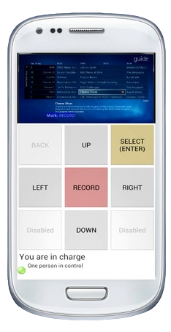

Block diagram
Power Supply
Base preparation
Glucose drip infusion mechanism
Sensors
Condition
Water Pump
Ultrasonic
Sensor
Distance <= 20
Obstacle detect
Mount motors
and wheels
If r <= 15 turn left
Bluetooth
Module
Mop placement
Microcontroller
If l<= 15 turn right
Physical Setup
Circuit Assembly
Autonomous system
Control system

Slide 6
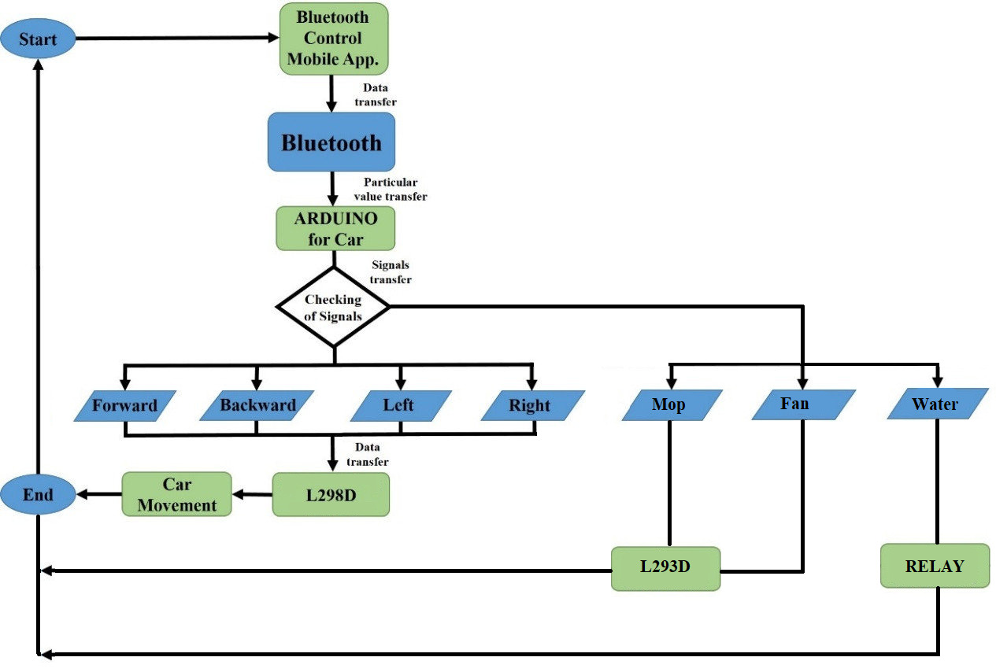

Slide 7

Components Required
Arduino Uno
Relay
BreadBoard
Cell Holder
Bluetooth Module
Water Pump
Spinning Mop
Voltage Regulator
Motor Driver Board
Lithium Battery
Viny Tubing
Clamp for Motor Geared motor
Ultrasonic Sensor
Resistor
Glucose Drip Pipe
On and off switch
LCD Display
Latching Push Button
Wheels of Motor
Water Bottle
Wire And Nut bolts

Slide 8


Software Used

Slide 9
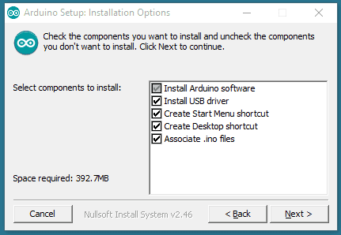
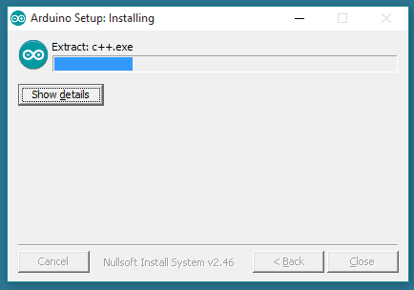
Arduino Installation

Slide 10
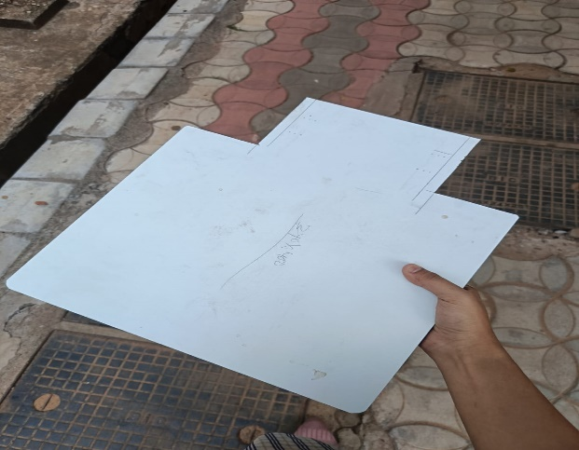
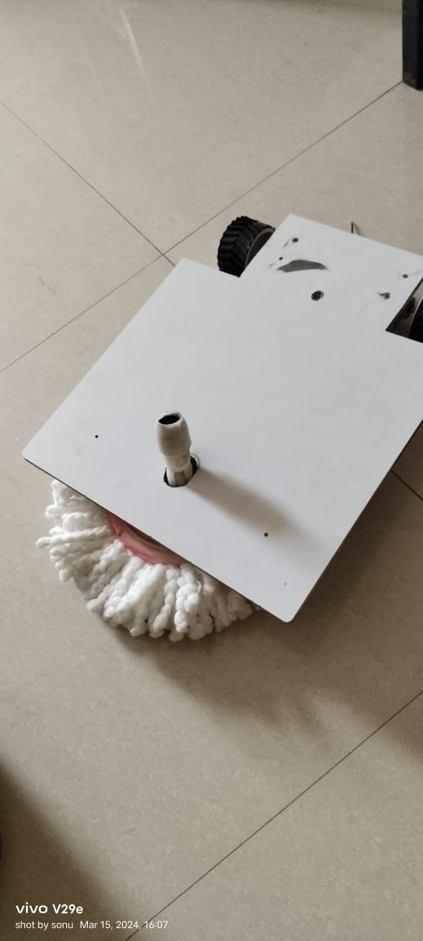
Base Preparation:
Start by preparing the base of the RoboVac. This can be made using a wooden board or any other suitable material. Cut the base according to the desired design and ensure it is sturdy and of the appropriate size for the components.

Slide 11
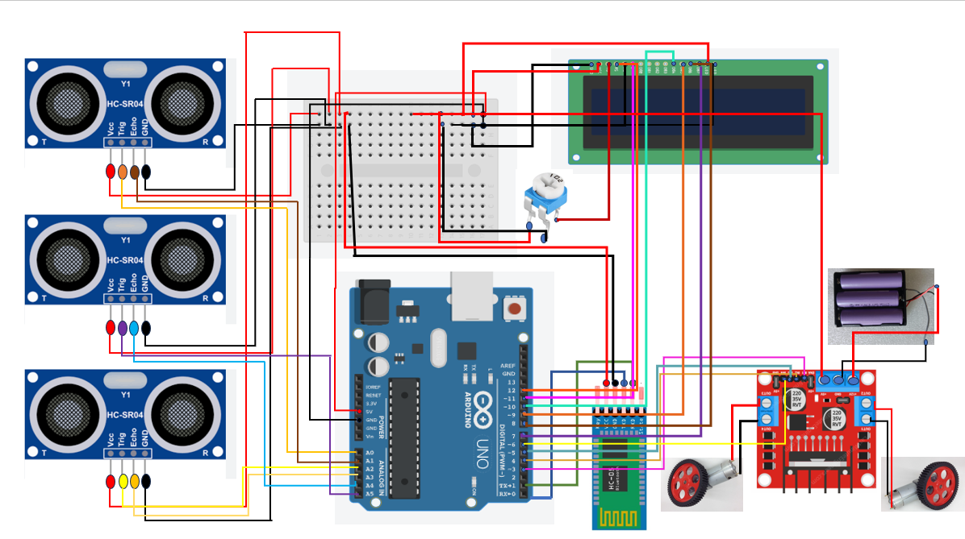
Circuit Connections

Slide 12
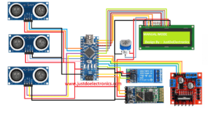

Slide 13
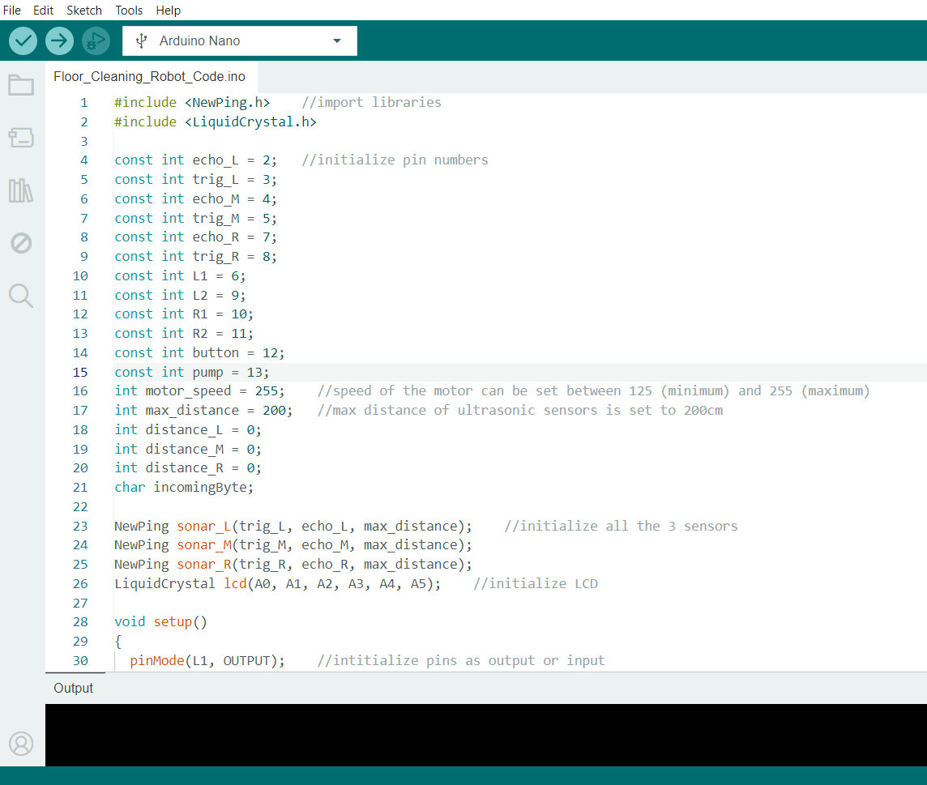

Slide 14
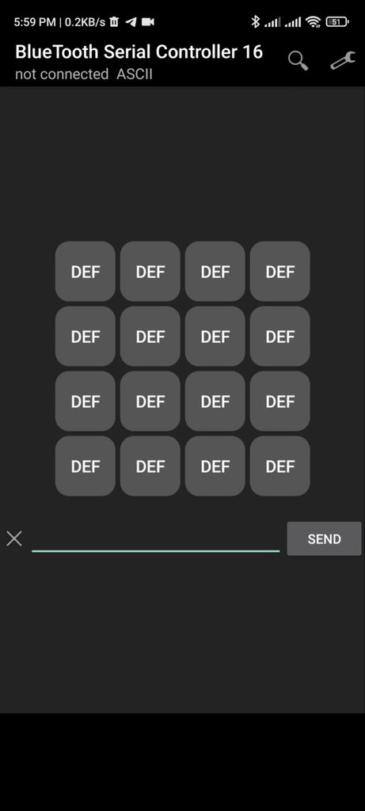
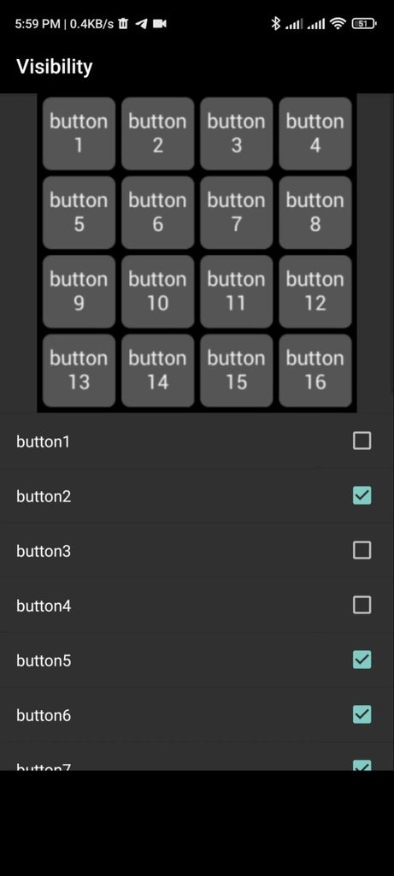
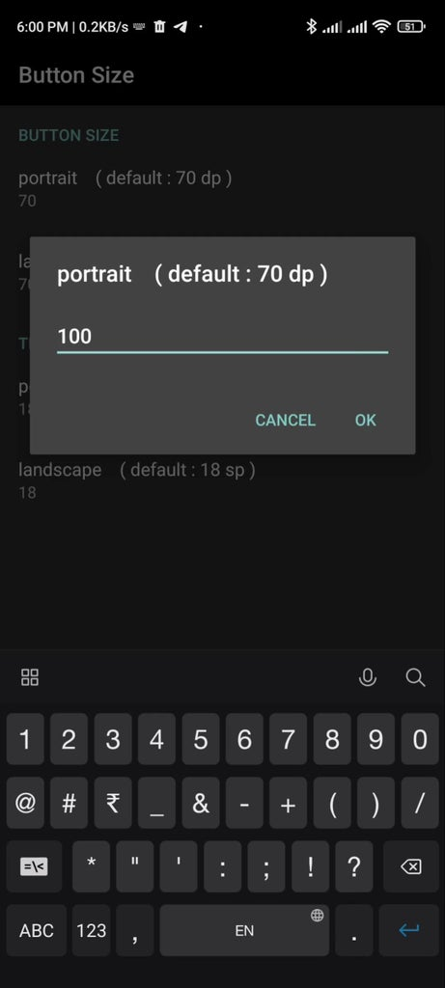
APP CONFIGURATION

Slide 15
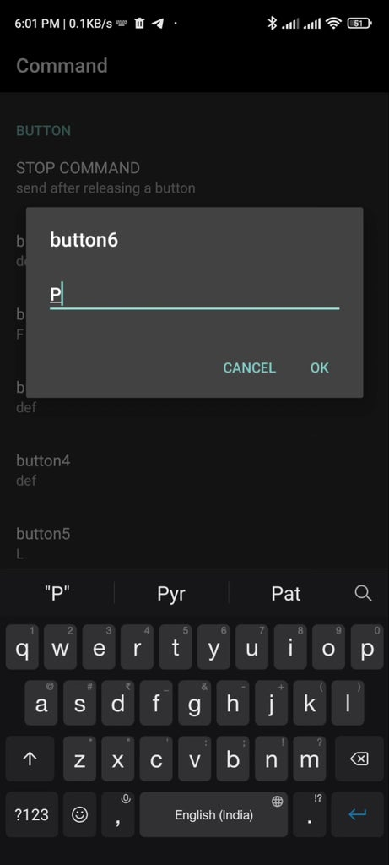
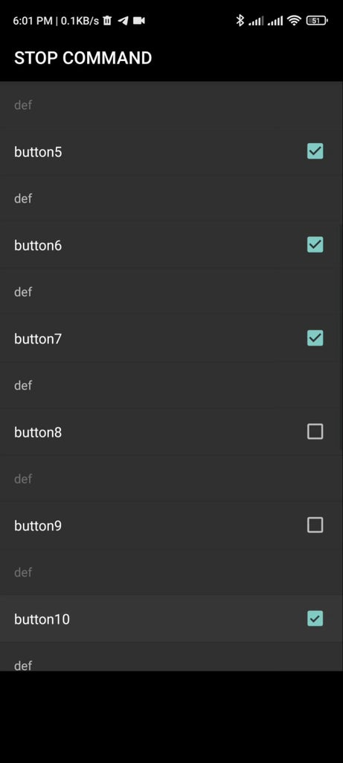
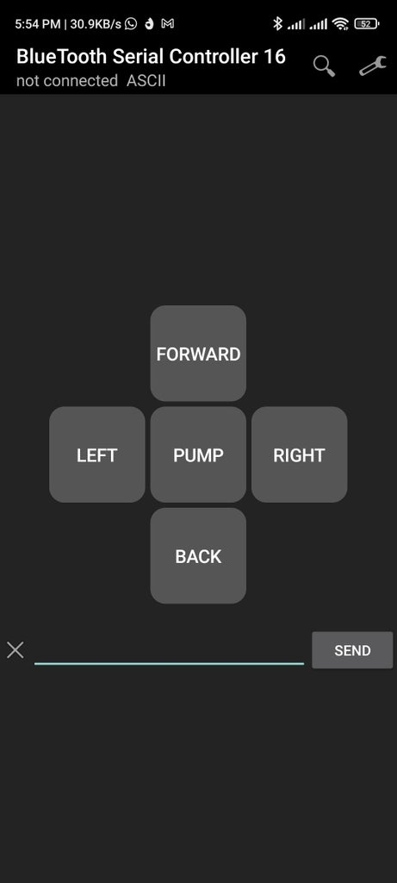

Slide 16
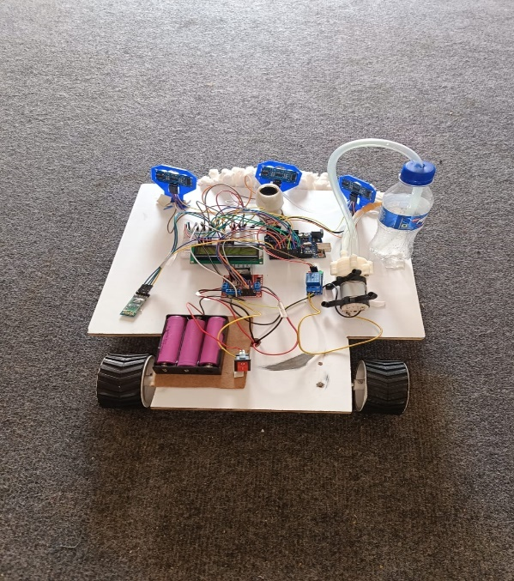
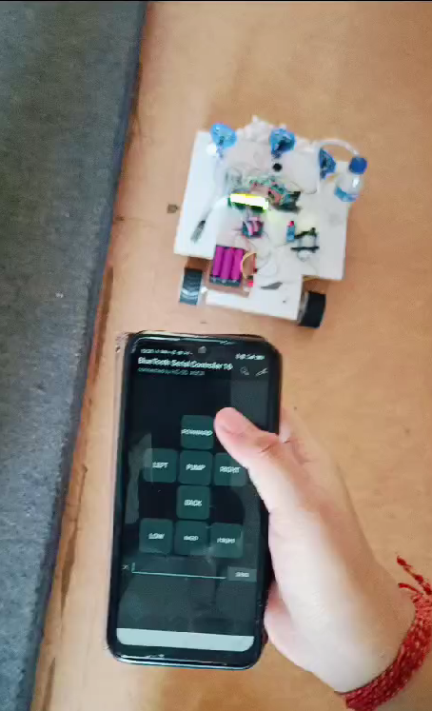

Slide 17
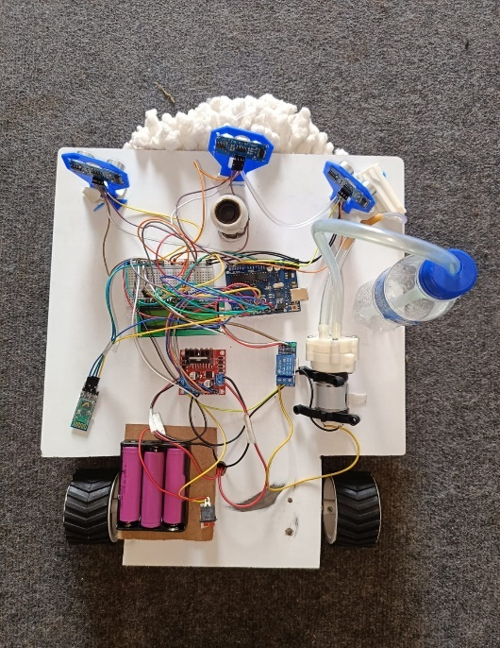
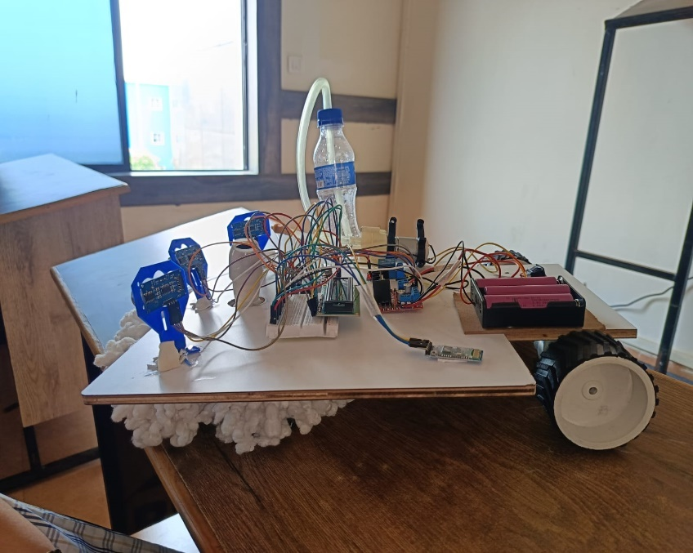

Slide 18
ADVANTAGES
Convenience: The Bluetooth control feature allows users to operate the RoboVac from anywhere using a smartphone or tablet, adding unparalleled convenience to the cleaning process.
Efficient Cleaning: Equipped with a brush system and advanced sensors, the RoboVac can effectively clean dust and dirt from hard floors and carpets, providing efficient and thorough cleaning results.
Smart Navigation: With its sensor-based navigation system, the RoboVac can intelligently map out spaces and navigate around obstacles, ensuring comprehensive cleaning coverage.
Customizable Cleaning Modes: The RoboVac offers various cleaning modes, allowing users to tailor its operation to specific cleaning needs, enhancing versatility and adaptability.
Water Control Mechanism: The inclusion of a glucose drip system for water control adds an innovative touch, potentially enhancing the robot's ability to tackle spills and sticky messes.

Slide 19
TIMELINE
Feb 2024
Components Collection
Feb 2024
Base design and preparation
March 2024
Hardware assembly and circuit connection
March 2024
Code making and upload
App configuartion
March 2024

Slide 20
Application
Home Cleaning
Educational Institutions
Industrial and Warehouse Settings
Office Cleaning
Retail Spaces
Hospital and Healthcare

Slide 21
